Slide 1
Parish Safeguarding
Officer Induction
Notes:
Welcome to the session and thank participants for attending.
Parish life is the heart of the Diocese and is the most important context to get our safeguarding right. The Parish Safeguarding Officer role is a vital one – the ‘champion’ of safeguarding in the parish.
Reflect back on the prior learning you have completed before attending this induction session – victims and survivors call to be listened to, believed and cared for.
As PSO they will look to you to listen to them, believe them, to act to refer concerns, to be open and transparent with them about what you are doing and why and to support them.
They want be central and therefore have control, as much as possible. Responsible staff in particular need to be trauma informed, and to go at the pace of the victim-survivor.
Source: Church of England Safeguarding Standards Consultation Report.pdf

Slide 2

Introduce Yourselves …
Who you are
Where are you from
What role(s) do you perform

Slide 3

What does your journey to becoming a Parish Safeguarding Officer look like?
What previous experience do you have?
What is your motivation for undertaking the role?
What personal qualities do you bring?
What ambitions do you have for the role going forward?

Slide 4




AIM:
To equip learners with an understanding of the role of the Parish Safeguarding Officer and induct them into key working practices and relationships
Learning outcomes
Understand the role, responsibilities and key working relationships of the PSO, including LA, DSA and PCC.
Create a development plan for safeguarding practice in their context.
Identify a variety of approaches to raising awareness and improving safeguarding practice.
Evaluate safeguarding information reported by members of the church or community and determining an appropriate responses.

Slide 5

The role of the Parish Safeguarding Officer
The Parish Safeguarding Officer is the key link between the diocese and the parish/s concerning safeguarding matters. She/he will have an overview of all church activities involving children, young people and vulnerable adults and will seek to ensure the implementation of safeguarding policy. The role can be taken by one person or the role shared, for example with one person covering children and the other, vulnerable adults.
The Parish Safeguarding Officer is a key leadership position in relation to safeguarding – but they are not solely responsible for safeguarding in their parish. To this end their role is about positively shaping the culture of safeguarding in the parish together with other leaders.

Slide 6
The role of the Parish Safeguarding Officer
The key tasks of the parish safeguarding officer are to:
Have an overview of all church activities involving children and vulnerable adults and keep a record of these activities.
Be familiar with diocesan safeguarding guidance and ensure that leaders of activities are fully aware of, and are implementing, this guidance.
Liaise with the incumbent over safeguarding issues.
Keep in touch with the leaders of all activities and offer them advice and support over safeguarding matters.
Liaise as necessary with the Diocesan Safeguarding Advisers. Report all concerns or allegations against church officers to the DSA.
Attend diocesan safeguarding training offered for PSOs.
Assist with safeguarding training in the parish as appropriate.
Attend a meeting of the church leadership (PCC) at least annually to ensure safeguarding issues are discussed and that the church leadership adopt the annual Church Safeguarding Policy.
Ensure that the Church Safeguarding Policy and contact details is displayed in all Church premises.
Keep good records of any safeguarding concerns that may arise and ensure that others do the same.
Promote inclusiveness in places of worship and within church activities.
Keep the church leadership informed of good safeguarding practice.
Undertake a regular parish safeguarding self-assessment in the format offered by the Diocese.

Slide 7




Policies, procedures and resources
Parish Safeguarding Handbook
PSO Check list
Safer environments
Promoting a safer church handbook
Safeguarding pocket guide
Safeguarding poster
Code of Safer Working Practice
Check the Lincoln Diocese website safeguarding resources page for more information and links.

Slide 8


Parish Safeguarding Checklist
The Safeguarding Dashboard is the most effective and streamlined way of checking the compliancy of parish safeguarding.
If you don’t have access as Parish Safeguarding Officer, email safeguardingdashboard@lincoln.anglican.org for permissions.

Slide 9
Responding…
Church and parish community
Parish Safeguarding Officers will be required to respond to safeguarding information which arises in these circumstances. These could include:
Pastoral encounters with members of the congregation or in the community
Information or observation about a child or adult at risk of harm which needs to be referred to statutory agencies
Information about those who pose a risk

Slide 10
Is it safeguarding?
Definitely – Perhaps – Definitely not
A child at a church club is frightened to go home because he is afraid his dad will punish him physically for getting a bad test result at school.
A physically disabled adult is reprimanded, patronised and excluded from some church activities because of her attention-seeking behaviour.
A man reports that as a child he was told in a confirmation class about hell and this terrified him, because he deduced that all his family would go to hell. His mother had a life-threatening illness at the time.
Kirsty, a 13-year-old girl, attends the church youth club with her friends, who are chatting with each other in the church kitchen after club. They refer to Mikey, one of the young leaders aged 18, who has made them all friends on Facebook and regularly messages Kirsty. She says he has asked her out, and she can’t decide whether to meet him.

Slide 11
Is it safeguarding? – scenarios continued
All of these required parish responses in the first instance. What would you do? Who would you tell? How it was dealt with at that stage could either cause more harm or lead forward to a sound process.
Supervision, boundaries and support for the staff involved in these activities where the concerns came to light is vitally important.
Having a heightened awareness for recognising where safeguarding concerns may be present may result in an increase in case issues and workload – whilst it might not immediately feel like it - this is a natural and positive result of being better informed!

Slide 12


You have recently attended a PCC meeting to give a safeguarding update on the agenda and learned that a number of the PCC are very unhappy about the fact that they need to undertake safeguarding training. They say that it is ridiculous and that they simply will not do it. One particular lady (who is considered a stalwart of the church and commands a lot of respect) has just said “if she has to do any form of safeguarding training then she will simply leave her role and the church will die without volunteers”. The lady goes on to say to the other members of the PCC “I have been at this church for over 20 years and there has never been any safeguarding things happen!! And what’s more there is unlikely to be any safeguarding things happen because the only time we get children is Easter and Christmas”.
How would you respond to these concerns raised by some PCC members and how would you address this?
-We are safeguarding both children and adults who might be vulnerable, and we may not know who the adults are.
-We are setting the standard for those coming into our church and taking on roles, therefore following safer recruitment guidance.
-We are creating a safe and welcoming space where people can explore their faith and flourish.

Slide 13

Dynamics to be aware of
TOXIC relationships - where you might feel unable to challenge someone’s attitude or behaviours
The Parish Safeguarding Officer is a key leadership position in relation to safeguarding – but are not solely responsible for safeguarding in their parish. To this end their role is about positively shaping the culture of safeguarding in the parish together with other leaders.
Relationships are therefore vital - but we need to acknowledge that not all will be positive and healthy.
OVERLY POSITIVE relationships – working alongside someone for many years, trusting, respecting, protecting and supporting. Imagine someone making an allegation against them – the safety of the potential victim must be at the forefront of your actions. All concerns must be passed on and confidentiality maintained.
DEFERENCE – being aware when deference can get in the way of good decision making and good safeguarding. We must all adhere to the same safeguarding standards.

Slide 14
What to do…?
R
R
R
R
ecognise
espond
ecord
efer
Notes:
14

Slide 15
KEY MESSAGES:
DO be calm
DO reassure
DO listen and observe carefully
DO record what has been said / communicated (date and sign it)
DO REFER WITHOUT DELAY
If you recognise something that causes you concern, don’t ignore it; respond.
The most important response will be to share/pass on your concerns to the DSA and involved them in the management of safeguarding issues in your parish – the DSA is your primary source of advice, support and guidance.
DO NOT show shock, distaste or disbelief
DO NOT introduce personal information or from either your own experience or that of others
DO NOT make comments about whom the allegation has been made.
DO NOT approach the person against whom the allegation has been made.
DO NOT ask leading questions or investigate.
DO NOT promise confidentiality - be clear you need to pass information on.
DO NOT tell the child, young person or vulnerable adult that “everything will be alright”.
DO NOT make promises that you cannot keep.
DO NOT try and manage / deal with everything yourself

Slide 16
Recording – the 4 W’s
Who
Who
What
When
REMEMBER
Was involved? (name the Key People)
Happened? (facts, not opinions)
Did it happen? (date & Time)
Was It was referred to?
sign and date your referral including the year
Notes:
16
16

Slide 17
KEY MESSAGES:
There is a proforma for safeguarding incident concerns and recording on the Church of England website.
Reports should ideally be concise and to the point, not rambling essays.
Take the name of the person to whom you have referred the matter.
Please remind delegates that they need to remember that this is their information, and that they are responsible for passing this information on to social services, the police or the DSA in writing.
Only verbally pass the information on if an emergency situation but they must find time as soon as possible to write down, don’t delay a referral to speak to somebody else if someone is at immediate risk of harm, dial 999.
Record exactly what you heard or observed. If possible do not add opinion but if you have to add an opinion make sure you describe it as such and why! Think about the communication issues disabled children have and how we can empower them to share their experience.
Accuracy is paramount.
The documents could be used in court and could therefore be your ‘original notes’ available for you to refer to many months later.
Date incl. the year and signature on every document is very important.

Slide 18






Social media
Social media sites enable users to create and share content and keep in touch with other users.
For many, especially young people, using social media is an extension of physical face-to-face relationships. It is therefore important that churches also engage with their community and worshippers through these platforms. However, this must be done safely to avoid the risk of:
• Forming inappropriate relationships
• Saying things you should not, such as offensive, sexual or suggestive comments
• Blurring the boundaries between public work/ministry and your private life
• Grooming and impersonation
• Bullying and harassment.
The PCC must approve the use of social media and mobile phones by the church.
Where there are Facebook or similar online groups set up on the church’s behalf, the PCC must ensure there is a named person to whom all workers are accountable. The named person must be a church ofﬁcer, and should be aware of the account name and password so that they can at any time log on to the account to monitor the communications. The named person should be proactive in fulﬁlling this role.

Slide 19
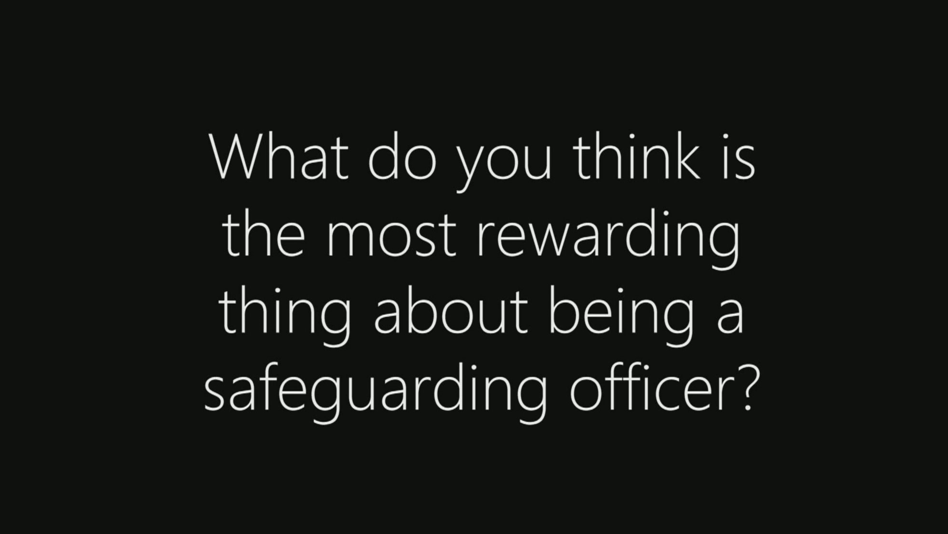
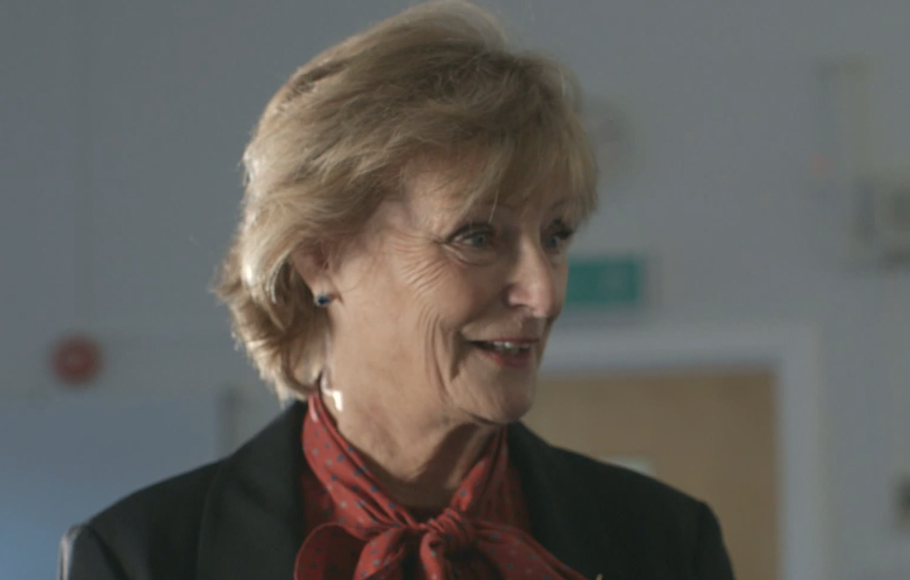
Hearing from another
The video provides details of the PSO role but also gives ideas on how to become more involved in parish life/activities.
PLEASE NOTE: The PSO in this video is from a huge parish, has PSO assistants, and is retired with masses of time on her hands and therefore is able to attend all activities!
PSO
https://player.vimeo.com/video/245066229

Slide 20
Do you have any questions or comments?
Contacts: safeguarding@lincoln.anglican.org safeguarding.admin@lincoln.anglican.org safeguarding.training@lincoln.anglican.org
DBS-checking@lincoln.anglican.org
Safeguarding - Lincoln Diocese (anglican.org)
Safeguarding: A safer church | The Church of England

